Slide 1
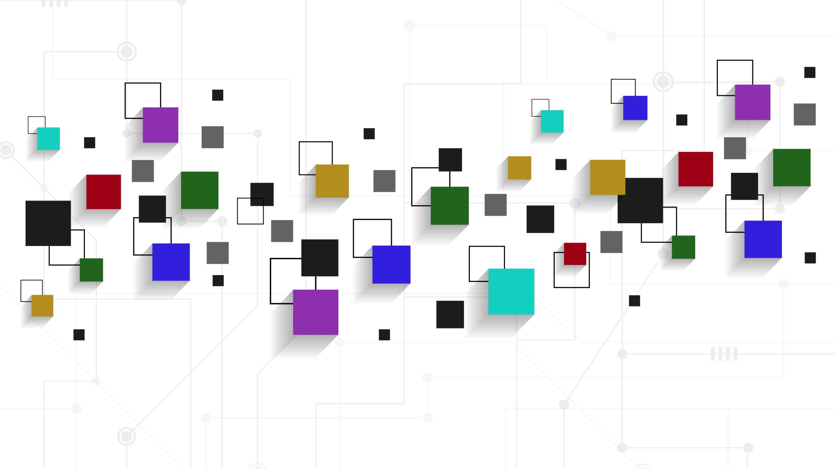
Integrative Project
Minecraft While the Model is being trained
Team:
Jesus Catzin Cetz
Pablo Duarte Tzuc
Héctor Hernadez Escalante

Slide 2
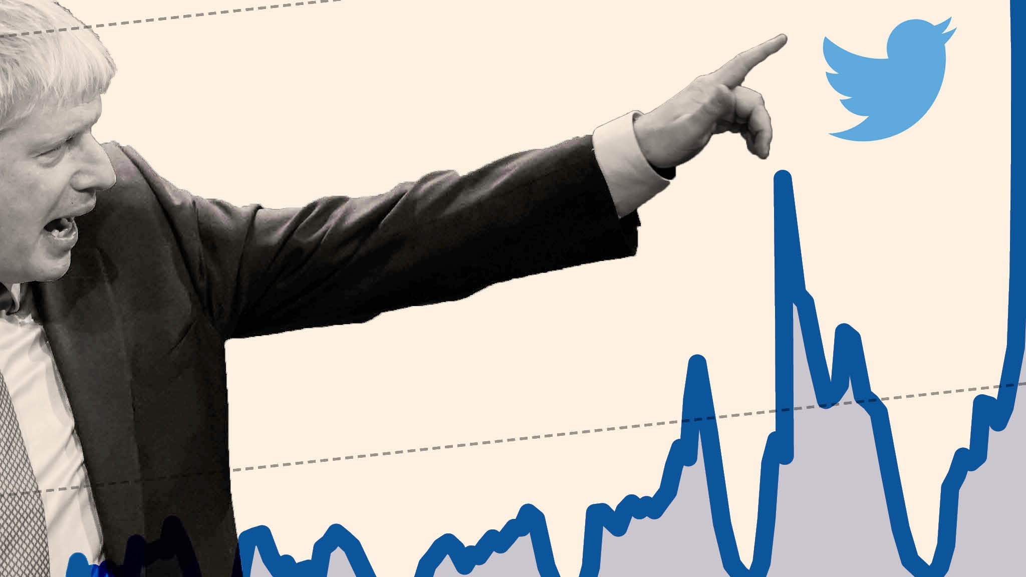
Introduction
Creation of a toxic classifier and tweet generation system that uses natural language processing, business intelligence, and machine learning trending techniques.

Slide 3
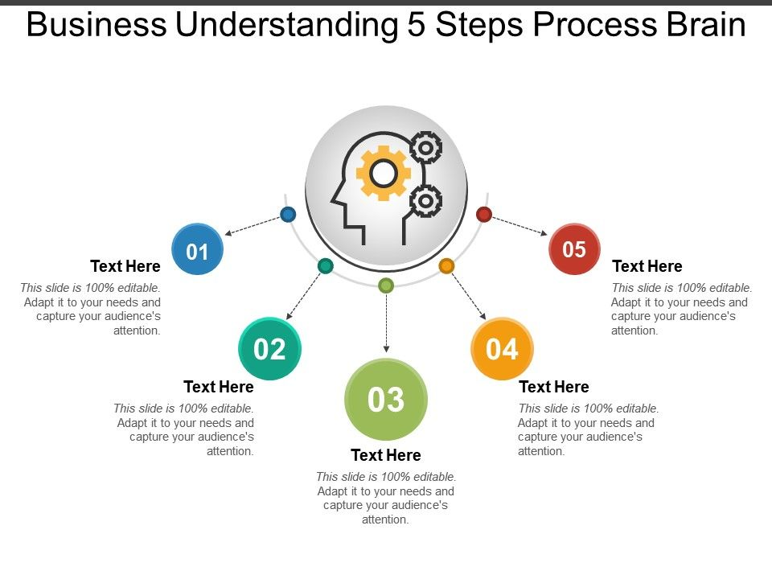
Business Understanding
Objective: Generates a classifier about toxic tweets and a generative tweet system
Sucess Criteria: The classifier must be able to clasify the tweets correctly, and the generative tweet system must generate a new tweet using a toxic tweets as a basis.

Slide 4
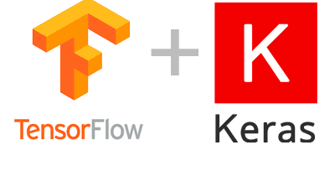
Current Solutions
Current solution
Creation and use of a deep learning classifier and generative model with Keras, Tensorflow and NLP libraries.
Use of the official Twitter API for the extraction of tweeters in real time, as well as their storage in MYSQL. To later connect MYSQL with Tableau and build the dashboard.
Report on work cycle and presentation of results.

Slide 5
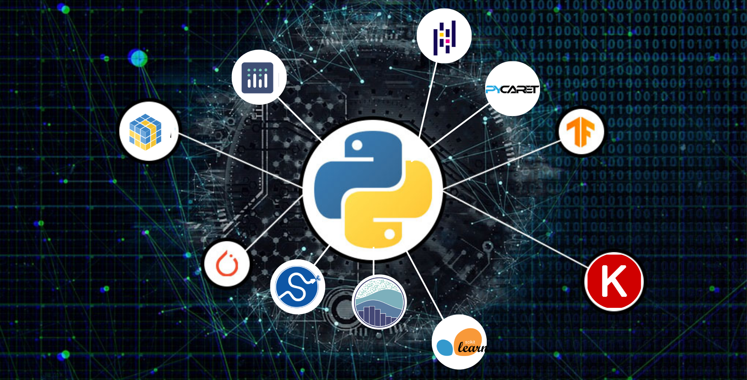
Technologies
Python
Scikit Learn
Keras
Tensorflow
Jupyter Notebook
Tableau
Selenium
Tweeter API
Colab

Slide 6
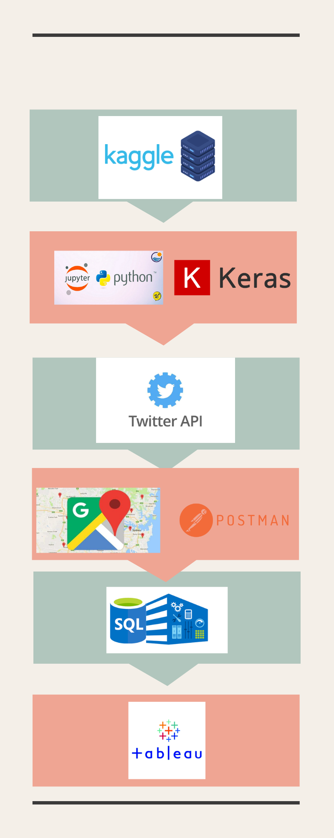
Workflow

Slide 7
Data Understanding
Initial Data Collection Report
Exploratory Analysis Report
Data quality report

Slide 8
Data Preparation
Datasets & Dataset Description
Data Cleaning
Integrate data
Format data:

Slide 9
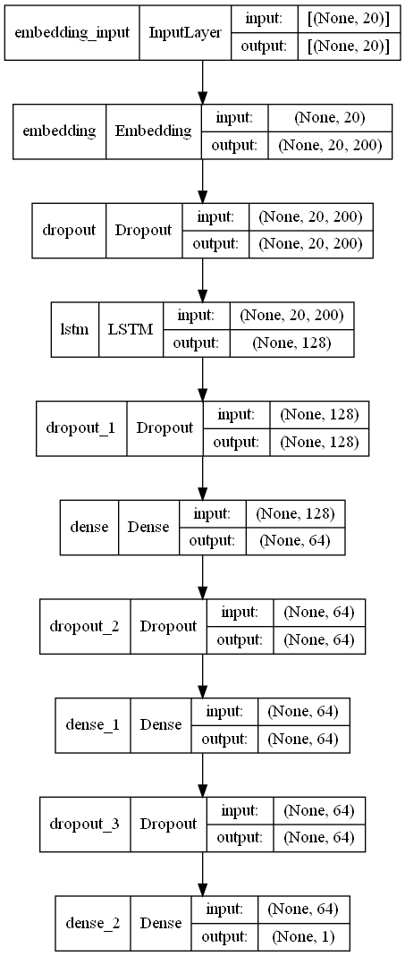
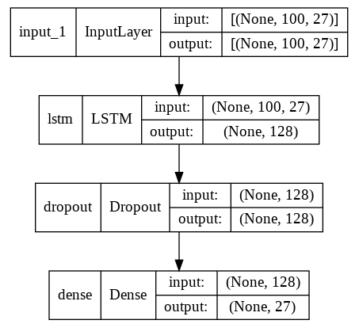
Modeling
Classifier System
Parameters:
Model Type: Sequential
o LSM: 128
o Dropout layers 1 and 2: 0.8
o Dropout layers 3 and 4: 0.7
o Activation Function: “Relu” and “Sigmoid
Generative System
Parameters:
Shape: The max length with which the model was implemented.
o LSM: 128
o Dropout: 0.5
o Dense: the length of the char
o Activation Function: Softmax

Slide 10
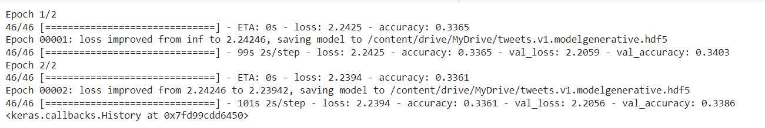
Experiments and results:
Toxic Classifier System
Accuracy: 0.9148
F1 Score: 0.9148
Tweet Generative System
Accuracy: 0.33 with continous improvement.

Slide 11
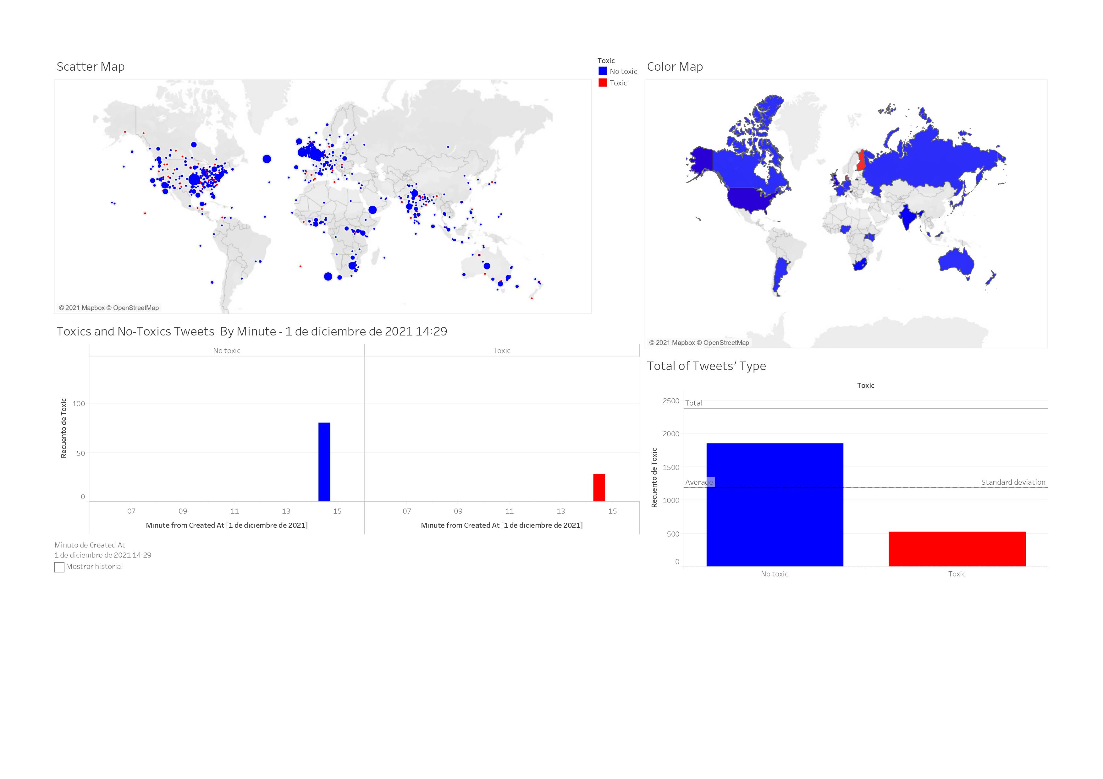
Deployment

Slide 12
Conclusions
The classifier model, we consider that first we could improve the processing step and carry out many other techniques to improve the model, it would include with different ways to make the embedding of the words like using prebuild models optimized for that. In addition, we would try to gather even more data to improve the model and avoid overfitting. Last, we would implement different types of neural networks to compare the performance, as well try different parameters.
Regarding the generative model, it is considered to get better resources, this is due the lack of having a server or a big computational power it was not possible to test fast the model and avoid doing backup a lot of times. In addition, we would possible try to use a different architectures for the processing as well as try others neural networks that could make a better job.

